Slide 1

Megan Wilcox
Climate Change
Greenhouse gasses are the most significant drivers of climate change in the world.
“Global Warming Potential”
Standard = Carbon Dioxide (CO₂)
Other gasses’ impact is calculated by converting to equivalent CO₂

Slide 2
Climate Change
Greenhouse gasses are the most significant drivers of climate change in the world.
“Global Warming Potential”
Standard = Carbon Dioxide (CO₂)
Other gasses’ impact is calculated by converting to equivalent CO₂
Megan Wilcox
United Nations (UN) Data
Carbon Dioxide (CO₂) Emissions in kiloton CO₂ equivalent
Methane (CH₄) Emissions in kiloton CO₂ equivalent

Slide 3
Is there significant correlation between a countries’ Carbon Dioxide Emissions and its Methane Emissions?
Climate Change
Greenhouse gasses are the most significant drivers of climate change in the world.
“Global Warming Potential”
Standard = Carbon Dioxide (CO₂)
Other gasses’ impact is calculated by converting to equivalent CO₂
United Nations (UN) Data
Carbon Dioxide (CO₂) Emissions in kiloton CO₂ equivalent
Methane (CH₄) Emissions in kiloton CO₂ equivalent

Slide 4

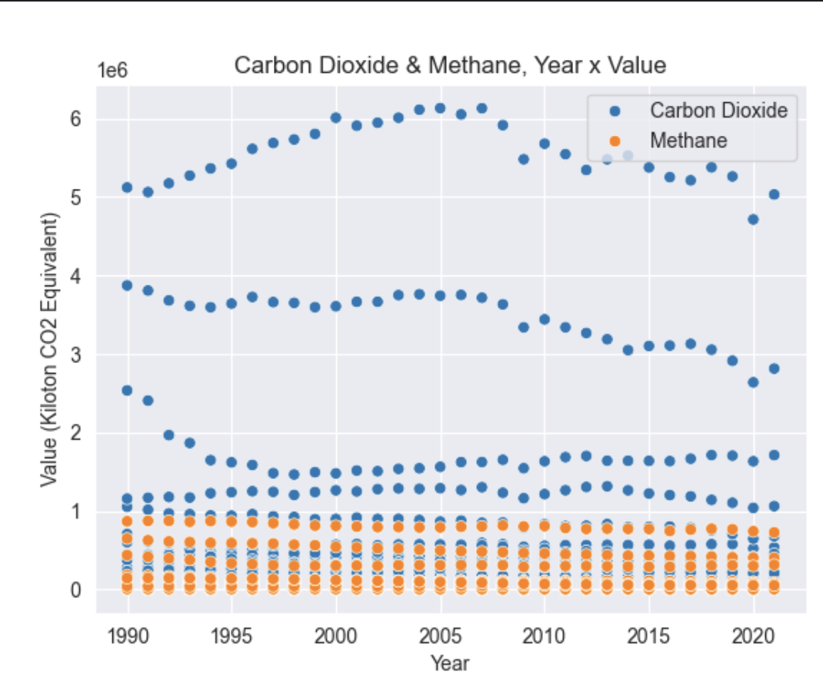
United Nations (UN) Data
Carbon Dioxide (CO₂) Emissions in kiloton CO₂ equivalent
Methane (CH₄) Emissions in kiloton CO₂ equivalent
Is there significant correlation between a countries’ Carbon Dioxide Emissions and its Methane Emissions?
Data Sets
Csv files to Pandas DataFrames: Country/Area, Year, Value
Years: 1990-2021
Countries: 43
Average Emissions
Carbon Dioxide (kilotons): 409,119.07 ± 994,921.46
Methane (kilotons CO₂ equivalent):
62,773.23 ± 146,335.63

Slide 5

Data Sets
Csv files to Pandas DataFrames: Country/Area, Year, Value
Years: 1990-2021
Countries: 43
Average Emissions
Carbon Dioxide (kilotons): 409,119.07 ± 994,921.46
Methane (kilotons CO₂ equivalent):
62,773.23 ± 146,335.63
Goals
Compare the rate of change in Carbon Dioxide v. Methane from 1990-2020 (inclusive).
Look for any correlation between the 2 rates of change.
Single DataFrame with the Following Columns/Series:
Country or Area
Change in Carbon Dioxide Emissions (1990-2020)
Change in Methane Emissions (1990-2020)

Slide 6
Data Sets
Csv files to Pandas DataFrames: Country/Area, Year, Value
Years: 1990-2021
Countries: 43
Average Emissions
Carbon Dioxide (kilotons): 409,119.07 ± 994,921.46
Methane (kilotons CO₂ equivalent):
62,773.23 ± 146,335.63
Goals
Compare the rate of change in Carbon Dioxide v. Methane from 1990-2020 (inclusive).
Look for any correlation between the 2 rates of change.
Single DataFrame with the Following Columns/Series:
Country or Area
Change in Carbon Dioxide Emissions (1990-2020)
Change in Methane Emissions (1990-2020)
Creating The New DataFrame
Created new DataFrames for Carbon Dioxide and Methane with 2 years per country (1990, 2020)
Initialized lists for emission change
Checked that the countries in each DataFrame matched. Created Panda Series with list of countries.
Loop to iterate through countries, both gases
Create temporary DataFrame
Identify value of emissions in 1990 and 2020
Append the difference (2020-1990) to lists for emission change
5. Consolidate Series + 2 lists into new DataFrame

Slide 7
Goals
Compare the rate of change in Carbon Dioxide v. Methane from 1990-2020 (inclusive).
Look for any correlation between the 2 rates of change.
Single DataFrame with the Following Columns/Series:
Country or Area
Change in Carbon Dioxide Emissions (1990-2020)
Change in Methane Emissions (1990-2020)
Creating The New DataFrame
Created new DataFrames for Carbon Dioxide and Methane with 2 years per country (1990, 2020)
Initialized lists for emission change
Checked that the countries in each DataFrame matched. Created Panda Series with list of countries.
Loop to iterate through countries, both gases
Create temporary DataFrame
Identify value of emissions in 1990 and 2020
Append the difference (2020-1990) to lists for emission change
5. Consolidate Series + 2 lists into new DataFrame
New DataFrame
Series/Columns:
Country or Area
Change in Carbon Dioxide 1990-2020
Change in Methane 1990-2020
Average Change in Emissions (kilotons CO₂ equivalent)
Carbon Dioxide: -99,170.19 ± 255,333.43
Methane: -22,703.13 ± 49,919.82

Slide 8
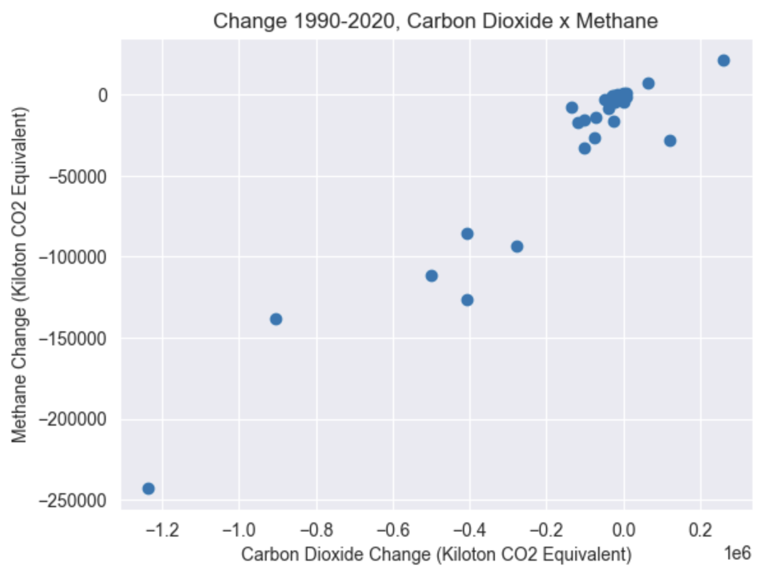
Creating The New DataFrame
Created new DataFrames for Carbon Dioxide and Methane with 2 years per country (1990, 2020)
Initialized lists for emission change
Checked that the countries in each DataFrame matched. Created Panda Series with list of countries.
Loop to iterate through countries, both gases
Create temporary DataFrame
Identify value of emissions in 1990 and 2020
Append the difference (2020-1990) to lists for emission change
5. Consolidate Series + 2 lists into new DataFrame
New DataFrame
Series/Columns:
Country or Area
Change in Carbon Dioxide 1990-2020
Change in Methane 1990-2020
Average Change in Emissions (kilotons CO₂ equivalent)
Carbon Dioxide: -99,170.19 ± 255,333.43
Methane: -22,703.13 ± 49,919.82
Pearson’ Correlation Coefficient
-1 = Negative Correlation
0 = No Correlation
1 = Positive Correlation
scipy.stats.pearsonr
Correlation = 0.9546

Slide 9
New DataFrame
Series/Columns:
Country or Area
Change in Carbon Dioxide 1990-2020
Change in Methane 1990-2020
Average Change in Emissions (kilotons CO₂ equivalent)
Carbon Dioxide: -99,170.19 ± 255,333.43
Methane: -22,703.13 ± 49,919.82
Pearson’ Correlation Coefficient
-1 = Negative Correlation
0 = No Correlation
1 = Positive Correlation
scipy.stats.pearsonr
Correlation = 0.9546
Conclusion
There is more likely than not a correlation between a countries’ changes in Carbon Dioxide Emissions and its Methane Emissions in a fixed period of time.

Slide 10
Pearson’ Correlation Coefficient
-1 = Negative Correlation
0 = No Correlation
1 = Positive Correlation
scipy.stats.pearsonr
Correlation = 0.9546
Conclusion
There is more likely than not a correlation between a countries’ changes in Carbon Dioxide Emissions and its Methane Emissions in a fixed period of time.

Slide 11
Specific Skills Used
Pandas
Numpy
Matplotlib
Seaborn
Scipy
Megan Wilcox
United Nations (UN) Data
Carbon Dioxide (CO₂) Emissions in kiloton CO₂ equivalent
Methane (CH₄) Emissions in kiloton CO₂ equivalent
If I had More Time
Do Pearson’s Correlation Coefficient again without the outliers to see if the outliers skewed my data.
Do a linear regression and plotted the line to better visual the correlation.
Turn the loop to create new DataFrame into function to minimize unnecessary repetition.

Slide 12
Specific Skills Used
Pandas
Numpy
Matplotlib
Seaborn
Scipy
If I had More Time
Do Pearson’s Correlation Coefficient again without the outliers to see if the outliers skewed my data.
Do a linear regression and plotted the line to better visual the correlation.
Turn the loop to create new DataFrame into function to minimize unnecessary repetition.
Megan Wilcox
United Nations (UN) Data
Carbon Dioxide (CO₂) Emissions in kiloton CO₂ equivalent
Methane (CH₄) Emissions in kiloton CO₂ equivalent

Slide 13
If I had More Time
Do Pearson’s Correlation Coefficient again without the outliers to see if the outliers skewed my data.
Do a linear regression and plotted the line to better visual the correlation.
Megan Wilcox
Megan Wilcox

Slide 14
Sources
https://www.epa.gov/climate-indicators/greenhouse-gases

